Slide 1

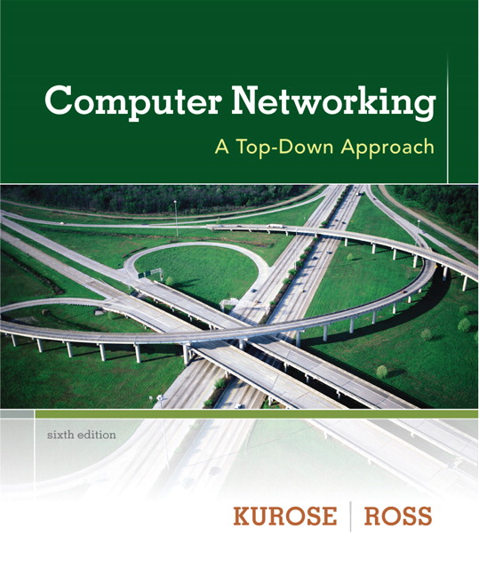
Chapter 1: Computer Network & Internet Computer Networking: A Top-Down Approach 6th edition Jim Kurose, Keith Ross Addison-Wesley

Slide 2
Outline
Our goal: get “feel” some basic terminology and concepts.
1.1 What is the Internet?
1.2 Network edge
end systems, access networks, links
1.3 Network core
network structure
1.4 Delay, loss and throughput
1.5 Protocol layers, service models (self-studying)
1.6 Networks under attack: security (self-studying)
1.7 History (self-studying)

Slide 3




















What’s the Internet?
PC
millions of connected computing devices:
hosts = end systems = end devices
running network apps
mobile network
server
wireless
laptop
global ISP
smartphone
home
network
communication links
fiber, copper, radio, satellite
transmission rate: bandwidth
regional ISP
wireless
links
wired
links
Packet switches: forward packets (chunks of data)
routers and switches
router
institutional
network
Notes:
3

Slide 4
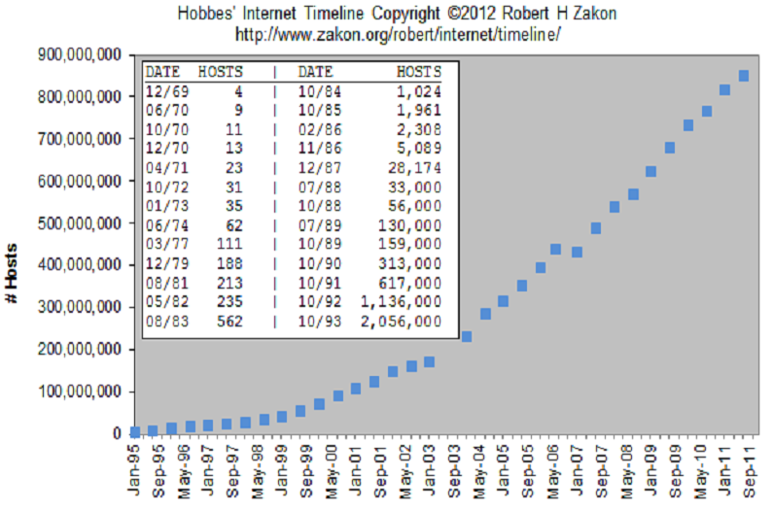
Growth of Internet Hosts

Slide 5
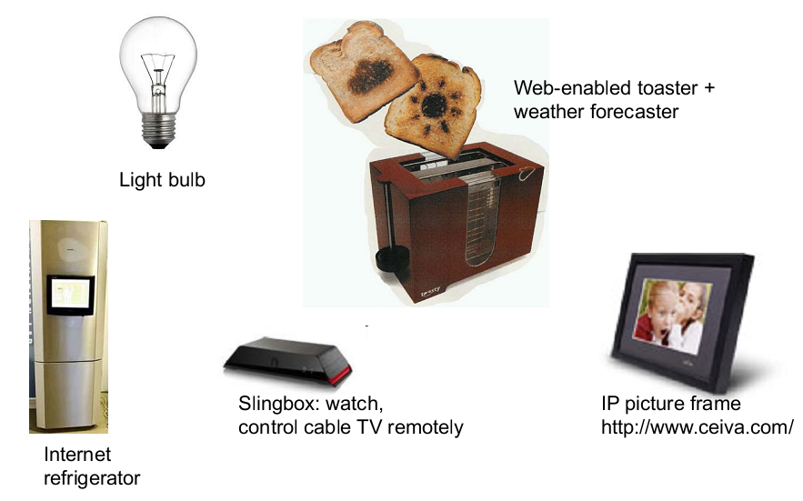
Internet appliances

Slide 6
What’s the Internet
Internet: “network of networks”
Interconnected ISPs
protocols control sending, receiving of msgs
e.g., TCP, IP, HTTP, Skype, 802.11
Internet standards
RFC: Request for comments
IETF: Internet Engineering Task Force
mobile network
global ISP
home
network
regional ISP
institutional
network

Slide 7
What’s the Internet: a service view
mobile network
Infrastructure that provides services to applications:
Web, VoIP, email, games, e-commerce, social nets, …
provides programming interface to apps
hooks that allow sending and receiving app programs to “connect” to Internet
provides service options, analogous to postal service
global ISP
home
network
regional ISP
institutional
network

Slide 8
What’s a protocol?
human protocols:
“what’s the time?”
“I have a question”
introductions
… specific msgs sent
… specific actions taken when msgs received, or other events
network protocols:
machines rather than humans
all communication activity in Internet governed by protocols
protocols define format, order of msgs sent and received among network entities, and actions taken on msg transmission, receipt

Slide 9



What’s a protocol?
a human protocol and a computer network protocol:
Hi
TCP connection
request
Hi
TCP connection
response
Got the
time?
Get http://www.awl.com/kurose-ross
2:00
<file>
time
Q: other human protocols?

Slide 10
Outline
1.1 What is the Internet?
1.2 Network edge
end systems, access networks, links
1.3 Network core
network structure
1.4 Delay, loss and throughput
1.5 Protocol layers, service models
1.6 Networks under attack: security
1.7 History

Slide 11

A closer look at network structure
network edge:
hosts: clients and servers
servers often in data centers
mobile network
global ISP
access networks, physical media: wired, wireless communication links
home
network
regional ISP
network core:
interconnected routers
network of networks
institutional
network

Slide 12
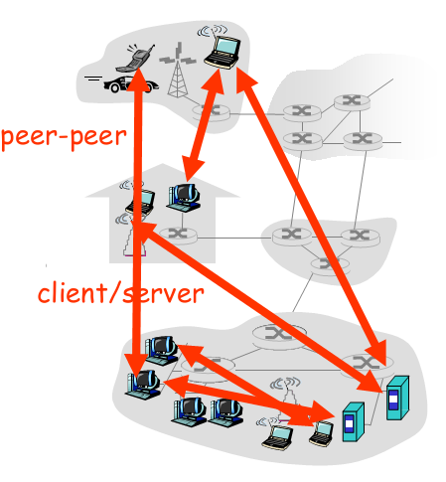
Access networks and physical media
end systems (hosts):
run application programs
e.g. Web, email
at “edge of network”
client/server model
client host requests, receives service from always-on server
e.g. Web browser/server; email client/server
peer-peer model:
minimal (or no) use of dedicated servers
e.g. Skype, BitTorrent

Slide 13


Access networks and physical media
Q: How to connect end systems to edge router?
residential access nets
institutional access networks (school, company)
mobile access networks
keep in mind:
bandwidth (bits per second) of access network?
shared or dedicated?

Slide 14
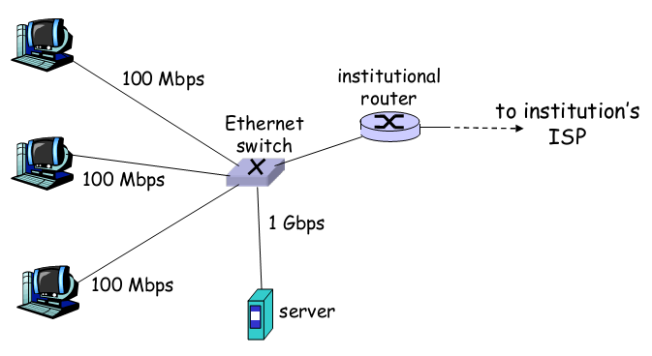
Ethernet Internet access
Typically used in companies, universities, etc…
10 Mbps, 100Mbps, 1Gbps, 10Gbps Ethernet
Today, end systems typically connect into Ethernet switch

Slide 15
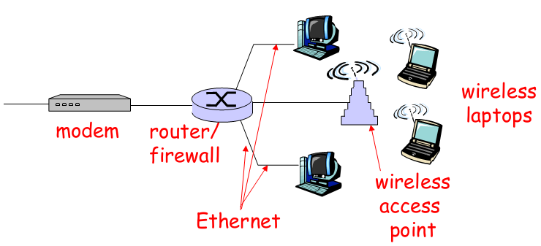
Home networks
Typical home network components:
DSL or cable modem
router/firewall/NAT
Ethernet
wireless access point

Slide 16
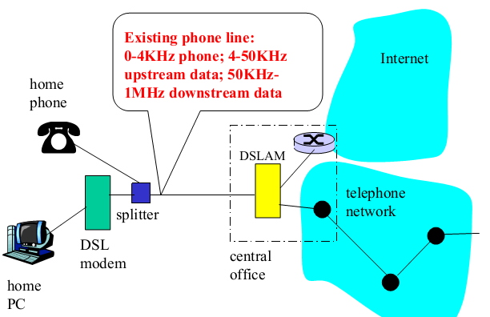
Digital Subscriber Line (DSL)
uses existing telephone infrastructure
up to 1 Mbps upstream
up to 8 Mbps downstream
dedicated physical line to telephone central office

Slide 17
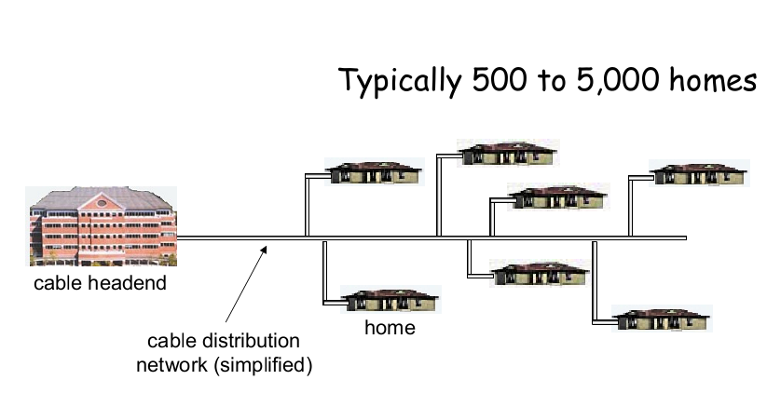
Cable Network Architecture: Overview

Slide 18
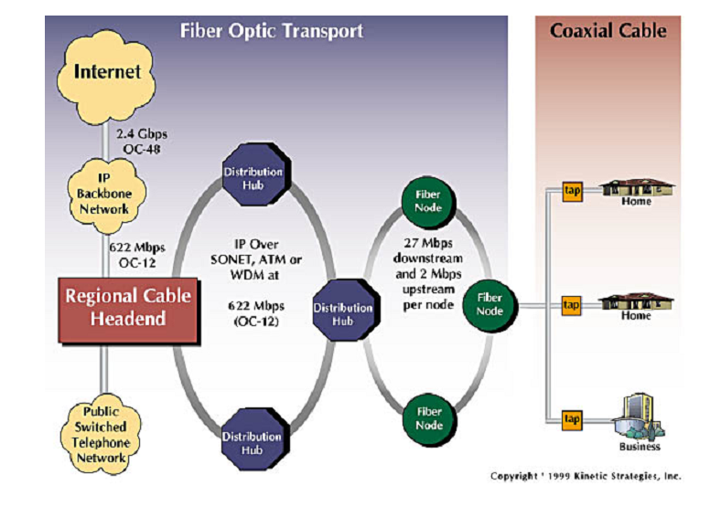
Residential access: cable modems

Slide 19
Residential access: cable modems
uses cable TV infrastructure, rather than telephone infrastructure
HFC: hybrid fiber coax
symmetric: up to 30Mbps downstream, 2 Mbps upstream
network of cable, fiber attaches homes to ISP router
homes share access to router
unlike DSL, which has dedicated access

Slide 20
Outline
1.1 What is the Internet?
1.2 Network edge
end systems, access networks, links
1.3 Network core
network structure
1.4 Delay, loss and throughput
1.5 Protocol layers, service models
1.6 Networks under attack: security
1.7 History

Slide 21
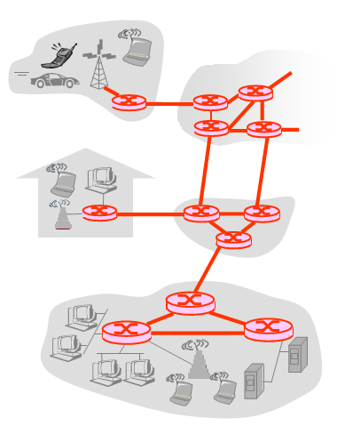
The Network Core
mesh of interconnected routers
the fundamental question: how is data transferred through net?
circuit switching: dedicated circuit per call: telephone net
packet-switching: data sent thru net in discrete “chunks”

Slide 22
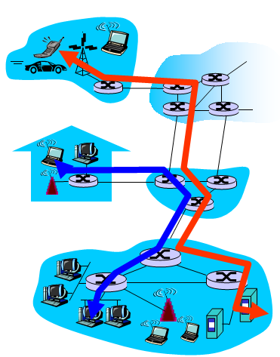
Network Core: Circuit Switching
end-end resources reserved for “call”
link bandwidth, switch capacity
dedicated resources: no sharing
circuit-like (guaranteed) performance
call setup required

Slide 23
Network Core: Circuit Switching
network resources (e.g., bandwidth) divided into “pieces”
pieces allocated to calls
resource piece idle if not used by owning call (no sharing)
dividing link bandwidth into “pieces”
frequency division
time division

Slide 24
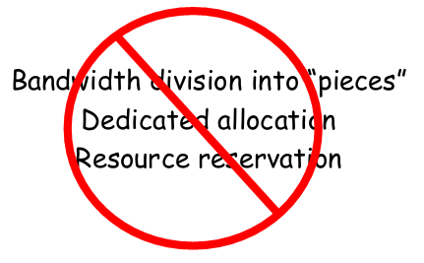
Network Core: Packet Switching
Each end-end data stream divided into packets
user A, B packets share network resources
each packet uses full link bandwidth
resources used as needed
Resource contention:
aggregate resource demand can exceed amount available
congestion: packets queue, wait for link use
store and forward: packets move one hop at a time
node receives complete packet before forwarding

Slide 25
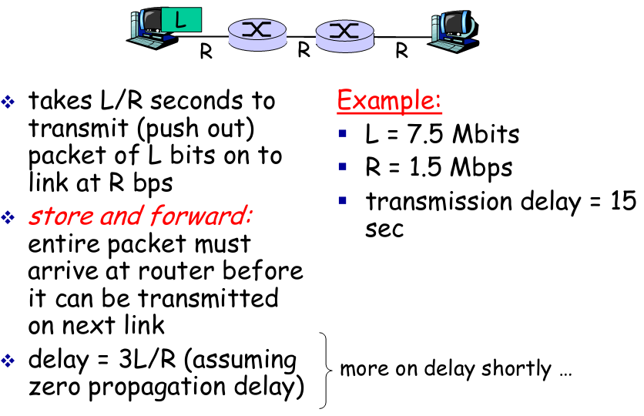
Packet-switching: store-and-forward

Slide 26
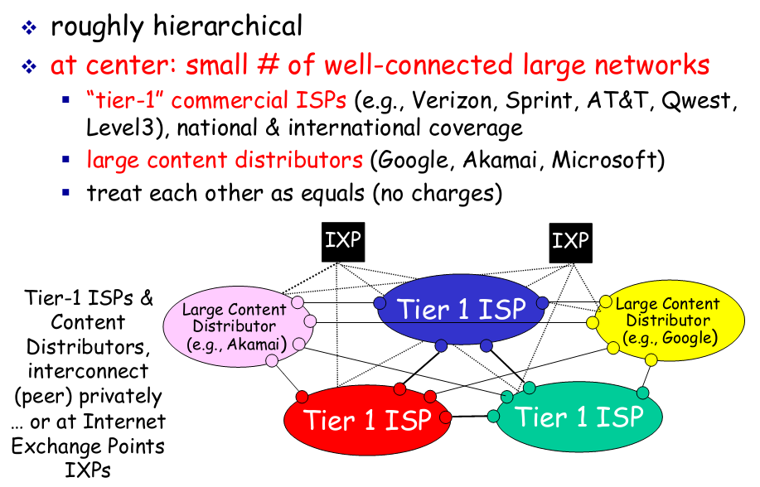
Internet structure: network of networks

Slide 27
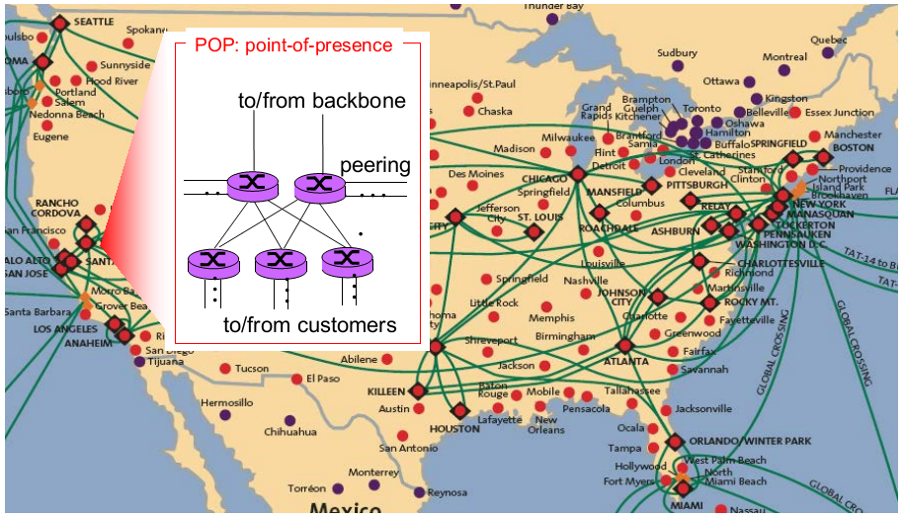
Tier-1 ISP: e.g., Sprint

Slide 28
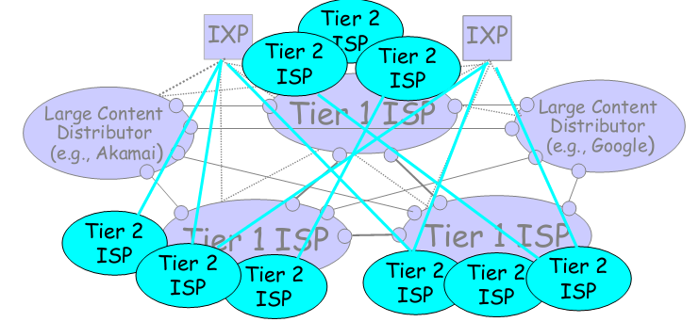
Internet structure: network of networks
“tier-2” ISPs: smaller (often regional) ISPs
connect to one or more tier-1 (provider) ISPs
each tier-1 has many tier-2 customer nets
tier 2 pays tier 1 provider
tier-2 nets sometimes peer directly with each other (bypassing tier 1) , or at IXP

Slide 29
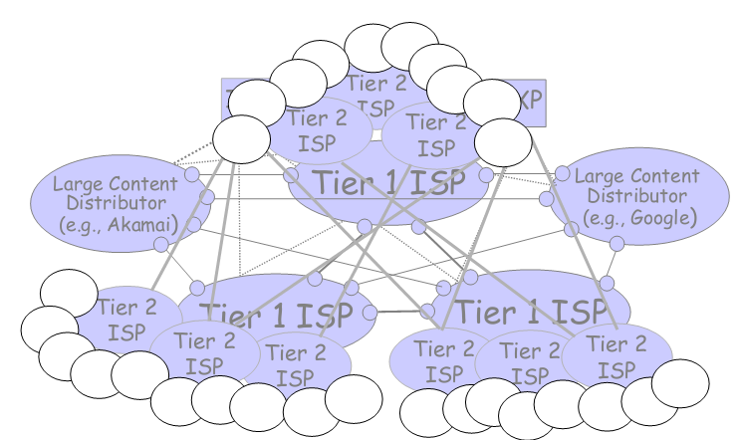
Internet structure: network of networks
“Tier-3” ISPs, local ISPs
customer of tier 1 or tier 2 network
last hop (“access”) network (closest to end systems)

Slide 30
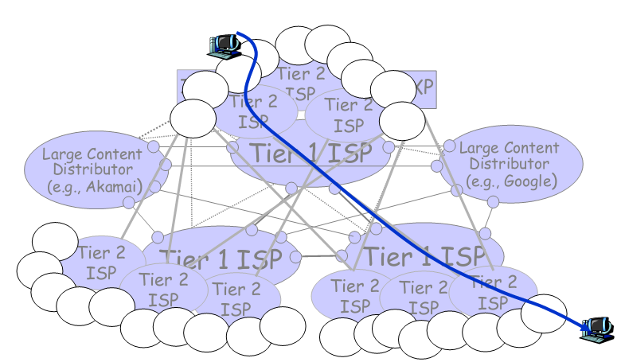
Internet structure: network of networks
a packet passes through many networks from source host to destination host

Slide 31
Outline
1.1 What is the Internet?
1.2 Network edge
end systems, access networks, links
1.3 Network core
network structure
1.4 Delay, loss and throughput
1.5 Protocol layers, service models
1.6 Networks under attack: security
1.7 History

Slide 32
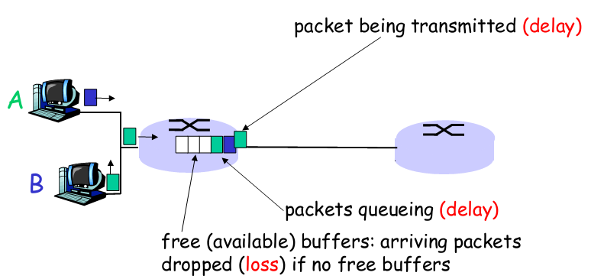
How do loss and delay occur?
packets queue in router buffers
packet arrival rate to link exceeds output link capacity
packets queue, wait for turn

Slide 33
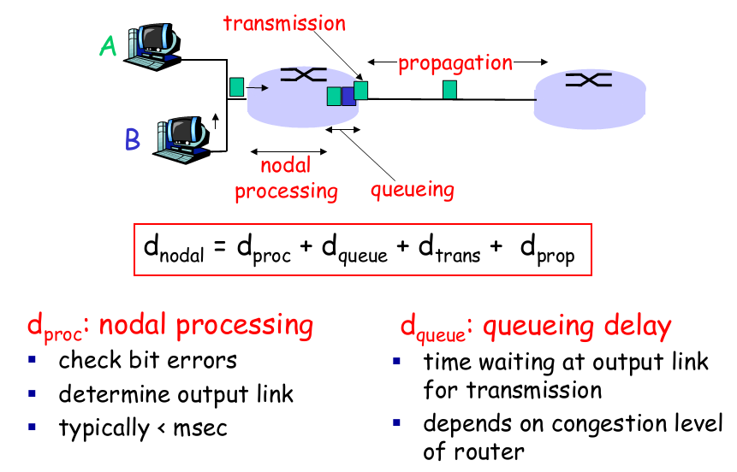
Four sources of packet delay

Slide 34
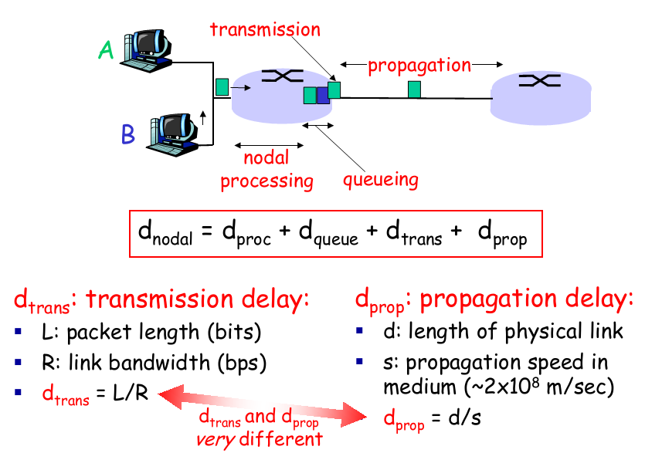
Four sources of packet delay

Slide 35
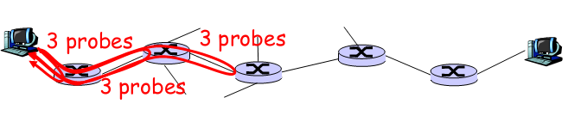
“Real” Internet delays and routes
What do “real” Internet delay & loss look like?
Traceroute program: provides delay measurement from source to router along end-end Internet path towards destination. For all i:
sends three packets that will reach router i on path towards destination
router i will return packets to sender
sender times interval between transmission and reply.

Slide 36
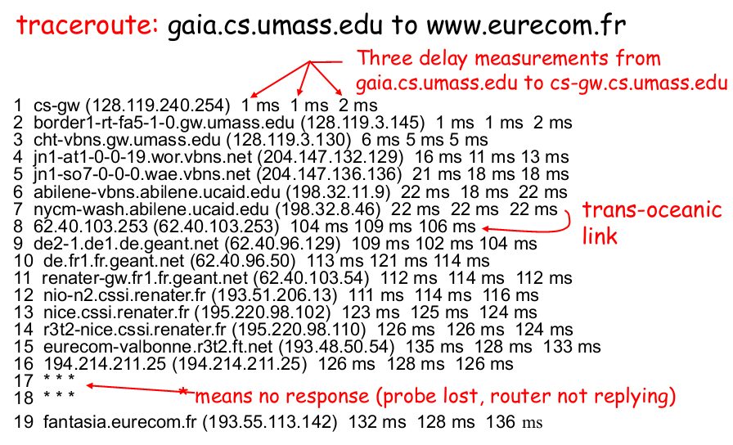
“Real” Internet delays and routes

Slide 37
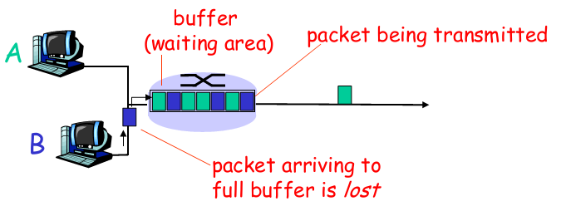
Packet loss
queue (aka buffer) preceding link in buffer has finite capacity
packet arriving to full queue dropped (aka lost)
lost packet may be retransmitted by previous node, by source end system, or not at all

Slide 38
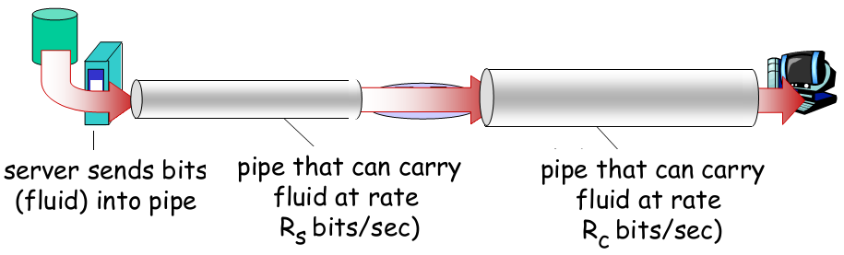
Throughput
throughput: rate (bits/time unit) at which bits transferred between sender/receiver
instantaneous: rate at given point in time
average: rate over longer period of time

Slide 39
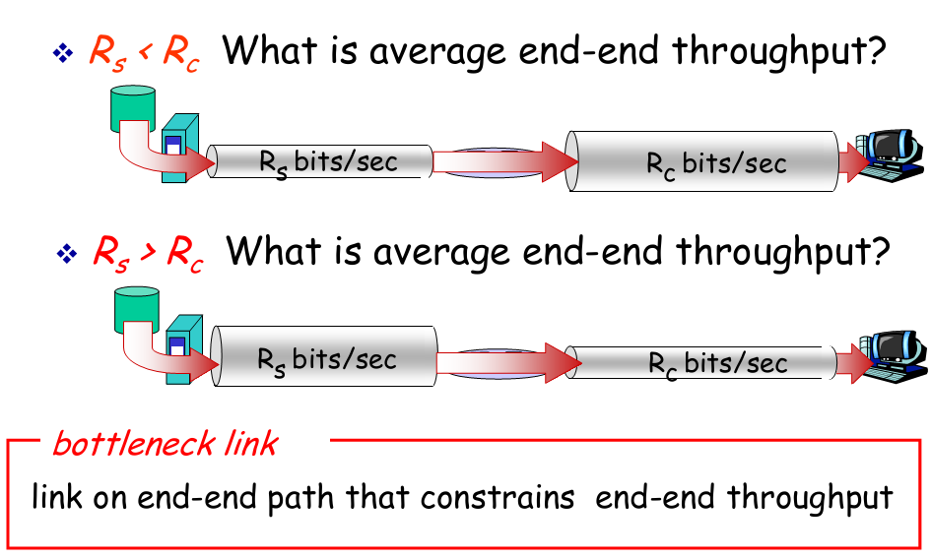
Throughput (more)

Slide 40
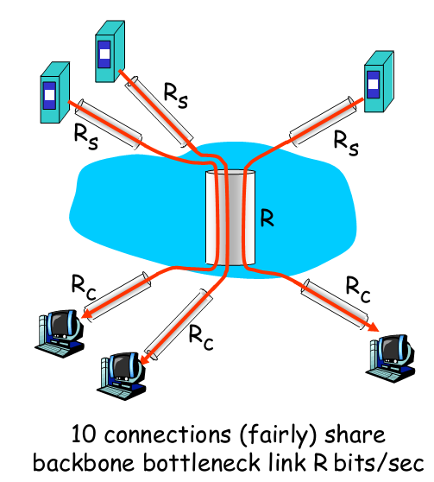
Throughput: Internet scenario
per-connection end-end throughput: min(Rc,Rs,R/10)
in practice: Rc or Rs is often bottleneck

Slide 41
Protocol “Layers”
Networks are complex, with many “pieces”:
hosts
routers
links of various media
applications
protocols
hardware, software
Question:
Is there any hope of organizing structure of network?
Or at least our discussion of networks?

Slide 42
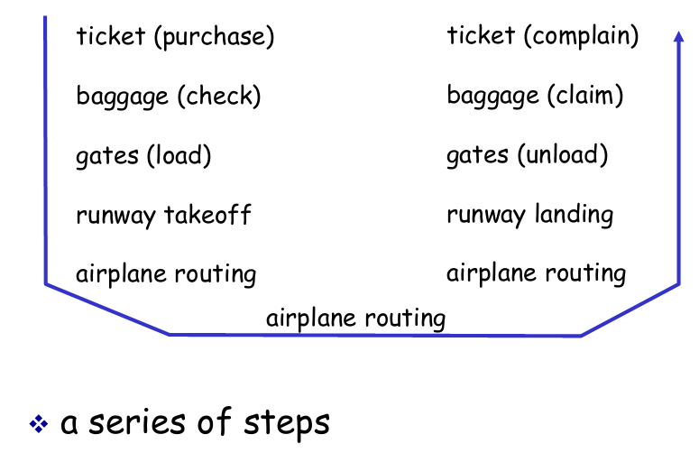
Organization of air travel

Slide 43
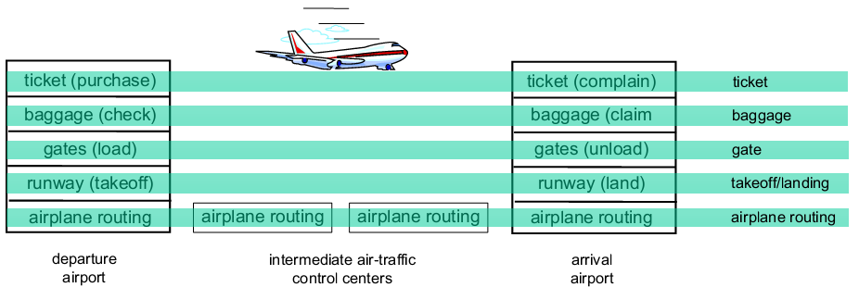
Layering of airline functionality
Layers: each layer implements a service
via its own internal-layer actions
relying on services provided by layer below

Slide 44
Why layering?
Dealing with complex systems:
explicit structure allows identification, relationship of complex system’s pieces
layered reference model for discussion
modularization eases maintenance, updating of system
change of implementation of layer’s service transparent to rest of system
e.g., change in gate procedure doesn’t affect rest of system
layering considered harmful?

Slide 45
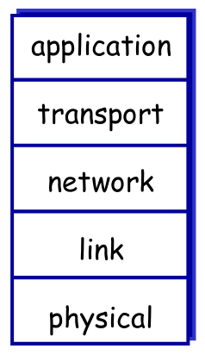
Internet protocol stack
application: supporting network applications
FTP, SMTP, HTTP
transport: process-process data transfer
TCP, UDP
network: routing of datagrams from source to destination
IP, routing protocols
link: data transfer between neighboring network elements
Ethernet, 802.111 (WiFi), PPP
physical: bits “on the wire”

Slide 46
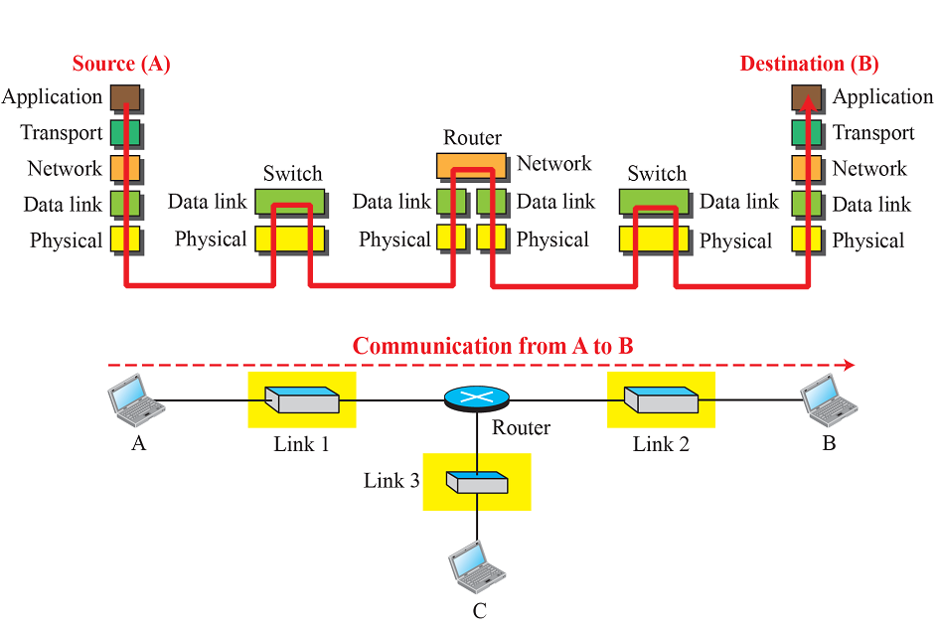
(F&M) Figure 1.13: Communication through an internet

Slide 47
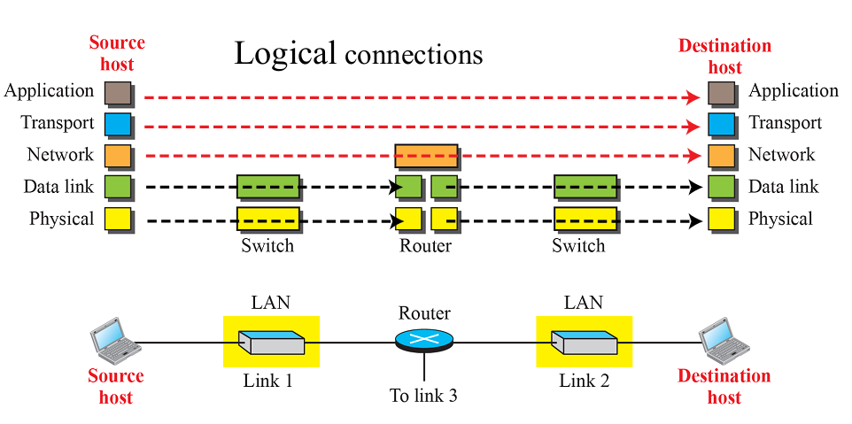
(F&M) Figure 1.14: Logical connections between layers in TCP/IP

Slide 48
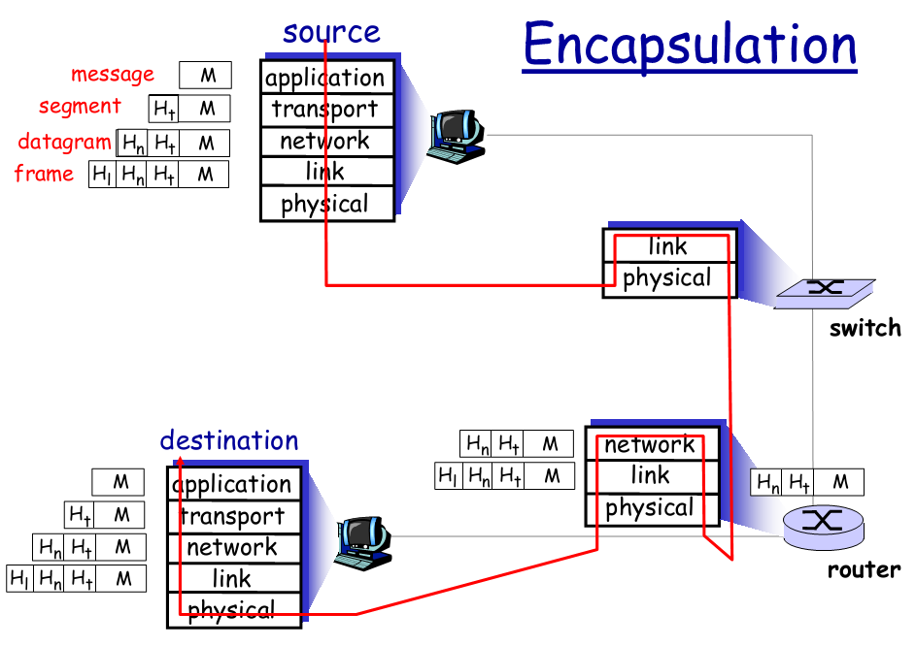
Encapsulation

Slide 49
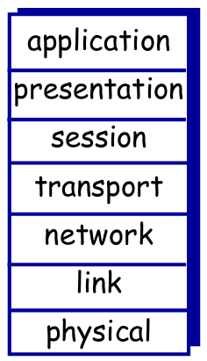
ISO/OSI reference model
presentation: allow applications to interpret meaning of data, e.g., encryption, compression, machine-specific conventions
session: synchronization, checkpointing, recovery of data exchange
Internet stack “missing” these layers!
these services, if needed, must be implemented in application
needed?

Slide 50
Who runs Internet?
IP address & Internet Naming administered by Network Information Centre (NIC)
Refer to: www.sgnic.net.sg; www.apnic.org
The Internet Society (ISOC) - Provides leadership in Internet related standards, education, and policy around the world.
The Internet Architecture Board (IAB) -Authority to issue and update technical standards regarding Internet protocols.
Internet Engineering Task Force (IETF) - Protocol engineering, development and standardization arm of the IAB.
Internet standards are published as RFCs (Request For Comments)
Refer to: www.ietf.org; for RFCs: http://www.ietf.org/rfc.html

Slide 51
Internet Standards
Internet Standards are developed by IETF (Internet Engineering Task Force) www.ietf.org
IETF Standards documents are called RFCs (Request For Comments) http://www.ietf.org/rfc.html
They define protocols such as TCP, IP, HTTP, SMTP
There are nearly 7000 RFCs (July 2013)
LAN/MAN Standards – are defined by IEEE 802 LAN/MAN Standards Committee. (Ethernet, WiFi…) http://www.ieee.org/portal/site

Slide 52
Outline
1.1 What is the Internet?
1.2 Network edge
end systems, access networks, links
1.3 Network core
network structure
1.4 Delay, loss and throughput
1.5 Protocol layers, service models
1.6 Networks under attack: security
1.7 History

